Slide 1
Software Development Life cycles
H17W34

Slide 2
Learning Intentions
Learning objectives for this lesson:
Software Development Life Cycle Models
Life Cycle Phases
Traditional VS current life cycles
Iterative and Incremental development
Prototypes

Slide 3
Software Development Life Cycle (SDLC)
A Software Development Life Cycle is defined as a structure that describes the stages involved in the development of a software.
Most projects follow a pattern throughout the life of a project.
From the original idea
Creating the project
Making any changes at a later date

Slide 4
Software Development Life Cycle
Various types of software methodologies exist, each with advantages and disadvantages.
The model of choice is said to be dependent on the nature of the project, schedule or even personal choice. They include:
Waterfall model
V model
Incremental model
RAD model
Agile model
Iterative model
Spiral model

Slide 5
The water fall model
System Feasibility
Requirement Analysis
Design
Code and Unit Testing
Integration & System Testing
Deployment & Maintenance

Slide 6
The water fall model steps
The
Phase
System Feasibility
On this phase, an analysis is performed to gather facts and determine the feasibility of the proposed software.

Slide 7
The water fall model steps
The
Phase
Requirement Analysis
This phase determines what the software is expected to do.
The analysis performed at this stage identified the functional and non-functional requirements.
The results of this analysis is captured in a requirement specification document.

Slide 8
The water fall model steps
The
Design
Phase
This phase outlines the interacting components of the software.
The output is a design specification which adheres to the requirement identified in the previous phase.

Slide 9
The water fall model steps
The
Phase
Code and Unit Testing
This phase involves writing and testing code.
Code is written in the chosen language using a style that is easy to read. As the code is written, it should be tested for any problems.
Testing should be documented in a test log

Slide 10
The water fall model steps
The
Phase
Integration & system testing
This phase involves putting all codes together in order to create the unified product.
You integrate all of the modules in the system and test them as a single system, making sure that the modules meet the requirements.

Slide 11
The water fall model steps
The
Deployment & Maintenance
Phase
This phase of the water fall model involves deploying the software system in the production environment, where it is put into operation for the intended uses by the end users.
This phase also involves carrying out maintenance as required.

Slide 12
Advantages of the water fall model
Waterfall model works well for smaller projects where requirements are very well understood and need to be clearly defined at the earlier stage.
It model allows for departmentalisation and strict management control.
Each phase of the development cycle has a distinct goal, allowing the developer
to set schedules with milestones .
It allows each stage of the development to proceed in strict order, reducing the risk to overlap.
It minimizes wasted effort and works well for technically weak or inexperienced team members.

Slide 13
Disadvantages of the water fall model
The water fall model has been subject to many critics. Many of these include the following:
It is said to be inflexible
Not suitable for projects where requirements can be changed or revisited.
Backing up to address mistakes is difficult
Once an application is in the testing stage, it is very difficult to go back and change something that was not well-thought out in the early stage
Not a good model for complex and object-oriented projects.

Slide 14
Task. 1 Think - Pair - Share
1.1 In your own words, what is the water fall model?
1.2 What is meant by Liner-sequential life cycle model?
1.3 List three advantages of the water fall model
1.4 List three Disadvantages of the water fall model

Slide 15
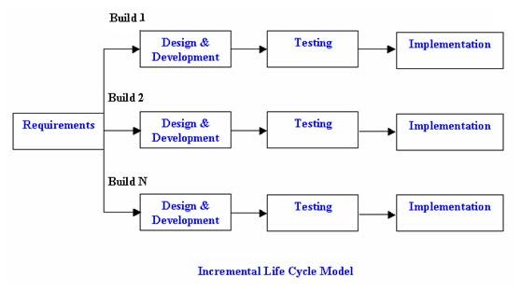
Incremental Life Cycle model

Slide 16
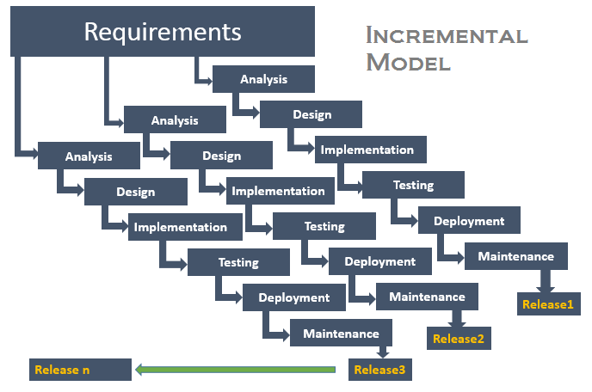
Incremental Life Cycle model
In incremental model, the whole requirements is divided into various builds. Multiple development cycles take place, making the life cycle a “multi-waterfall” cycle
Each requirement goes through
a development cycle independently
and develop separately.

Slide 17
Incremental Life Cycle model
A working version of software is produced during the first module, so you have working software early on during the software life cycle.
Each subsequent release of the module
adds function to the previous release.
The process continues till the complete
product is completed.
.

Slide 18
Advantages of Incremental Model:
Generates working software quickly and early during the software life cycle.
This model is more flexible – less costly to change scope and requirements.
Easier to test and debug during a smaller iteration.
Each iteration is an easily managed milestone.
In this model customer can respond to each built.
Easier to manage risk because risky pieces are identified and handled during its iteration.

Slide 19
Disadvantages of Incremental Model:
Needs a clear and complete definition of the whole system that can be broken down and built incrementally.
Required a good planning and design.
Each phase of an iteration is rigid and do not overlap each other.
Problems may arise pertaining to system architecture if all requirements of the entire software life cycle is not gathered up front.

Slide 20
When to use the Incremental Model:
This model can be used when the requirements of the complete system are clearly
defined and understood.
Major requirements must be defined; however, some details can evolve with time.
There is a need to get a product to the market early.
Resources with needed skill set are not available.
There is a need to get a product to the market early.
There are some high risk features and goals

Slide 21
Task. 2 Think - Pair - Share
2.1 In your own words, what is an Incremental Model?
2.2 When would you use an Incremental Model?
2.3 List three advantages of the Incremental Model
2.4 List three Disadvantages of the Incremental Model

Slide 22
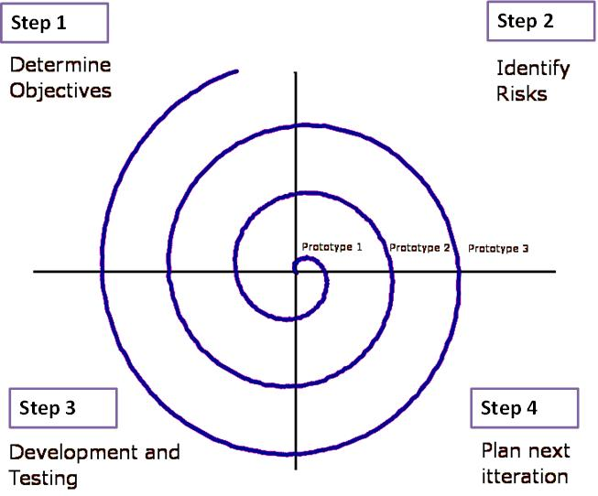
The spiral model

Slide 23
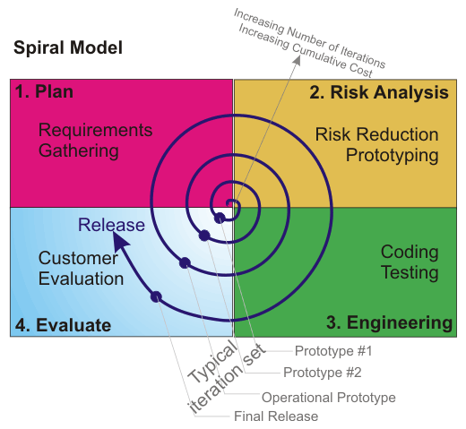
The spiral model is similar to the incremental model, with more emphasis placed on risk
analysis. The spiral model has four phases:
Planning, Risk Analysis, Engineering
and Evaluation.
A software project repeatedly passes through
these phases in iterations (called Spirals).
The baseline spiral, starts in the planning
phase, requirements are gathered and risk is
assessed. Each subsequent spirals builds on
the baseline spiral.

Slide 24
Advantages of Spiral Model
High amount of risk analysis hence, avoidance of Risk is enhanced.
Good for large and mission-critical projects.
Strong approval and documentation control..
Additional Functionality can be added at a later date.
Software is produced early in the software life cycle.

Slide 25
Disadvantages of Spiral Model
Can be a costly model to use.
Risk analysis requires highly specific expertise.
Project’s success is highly dependent on the risk analysis phase.
Doesn’t work well for smaller projects..
It is complicated and requires attentive and knowledgeable management to pull it off.

Slide 26
When to use Spiral Model:
When costs and risk evaluation is important.
For medium to high-risk projects
Users are unsure of their needs.
Requirements are complex
Significant changes are expected (research and exploration).

Slide 27
Task. 3 Think - Pair - Share
3.1 In your own words, what is the Spiral Model?
3.2 When would you use the Spiral Model?
3.3 List three advantages of the Spiral Model
3.4 List three Disadvantages of the Spiral Model

Slide 28
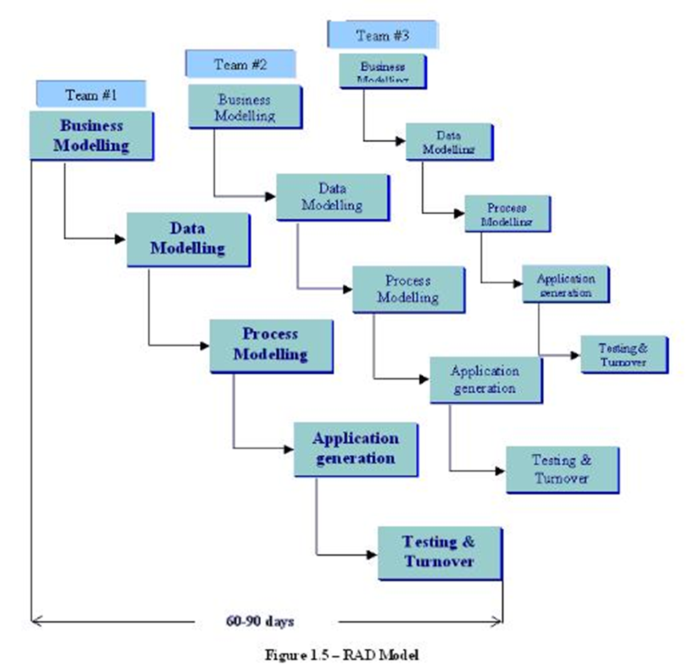
The Rapid
Development Model

Slide 29
The Rapid Development model
RAD model is Rapid Application Development model. It is a type of incremental model
In RAD model the components or functions are developed in parallel as if they were mini projects.
The developments are time boxed, delivered and then assembled into a working prototype
This can quickly give the customer something to see and use and to provide feedback regarding the delivery and their requirements.

Slide 30
The phases in the rapid application development (RAD) model are:
Business modelling:
The information flow is identified between various business functions.
Data modelling: Information gathered from business modelling is used to define data objects that are needed for the business.
Process modelling: Data objects defined in data modelling are converted to achieve the business information flow to achieve some specific business objective
Application generation: Automated tools are used to convert process models into code and the actual system.
Testing and turnover: Test new components and all the interfaces

Slide 31
Advantages of RAD Model
Reduced development time.
Increases reusability of components.
Encourages customer feedback
Quick initial reviews occur..
Integration from very beginning solves a lot of integration issues.

Slide 32
Disadvantages of RAD Model
Depends on strong team and individual performances for identifying the business requirements..
Only system that can be modularized can be built using RAD
Requires highly skilled developers/designers
Inapplicable to cheaper projects as cost of modelling and automated code generation is very high.
High dependency on modeling skills.

Slide 33
Task. 4 Think - Pair - Share
4.1 In your own words, what is the RAD Model?
4.2 List three advantages of the RAD Model
4.3 List three Disadvantages of the RAD Model

Slide 34
Task. 5 Think - Pair - Share
5.1 Compare the water fall model against the Spiral model?
5.2 Identify three differences between these Models
5.3 Why would you use one over the other?

